Slide 1
Mining Massive Datasets
Wu-Jun Li
Department of Computer Science and Engineering
Shanghai Jiao Tong University
Lecture 2: MapReduce and Hadoop

Slide 2
Single-node architecture
CPU
Machine Learning, Statistics
Memory
“Classical” Data Mining
Disk

Slide 3
Commodity Clusters
Web data sets can be very large
  Tens to hundreds of terabytes
Cannot mine on a single server (why?)
Standard architecture emerging:
  Cluster of commodity Linux nodes
  Gigabit ethernet interconnect
How to organize computations on this architecture?
  Mask issues such as hardware failure

Slide 4
Cluster Architecture
2-10 Gbps backbone between racks
1 Gbps between
any pair of nodes
in a rack
Switch
Switch
Switch
CPU
CPU
CPU
CPU
Mem
…
Mem
Mem
…
Mem
Disk
Disk
Disk
Disk
Each rack contains 16-64 nodes

Slide 5
Distributed File System

Slide 6
Stable storage
Distributed File System
First order problem: if nodes can fail, how can we store data persistently?
Answer: Distributed File System
  Provides global file namespace
  Google GFS; Hadoop HDFS; Kosmix KFS
Typical usage pattern
  Huge files (100s of GB to TB)
  Data is rarely updated in place
  Reads and appends are common

Slide 7
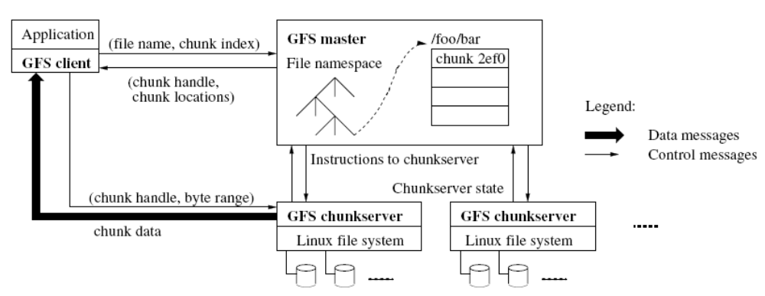
Distributed File System
Distributed File System
Google file system (GFS)

Slide 8
Distributed File System
Distributed File System
Chunk Servers
  File is split into contiguous chunks
  Typically each chunk is 16-64MB
  Each chunk replicated (usually 2x or 3x)
  Try to keep replicas in different racks
Master node
  a.k.a. Name Nodes in HDFS
  Stores metadata
  Might be replicated
Client library for file access
  Talks to master to find chunk servers
  Connects directly to chunk servers to access data

Slide 9
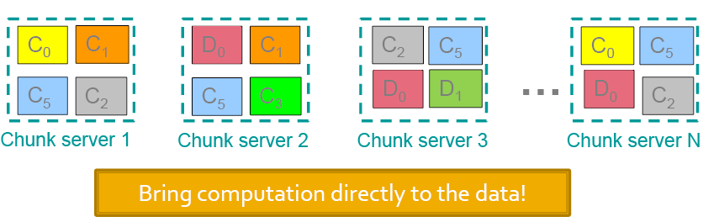
Distributed File System
Distributed File System

Slide 10
MapReduce

Slide 11
Warm up: Word Count
MapReduce
We have a large file of words, one word to a line
Count the number of times each distinct word appears in the file
Sample application: analyze web server logs to find popular URLs

Slide 12
Word Count (2)
MapReduce
Case 1: Entire file fits in memory
Case 2: File too large for mem, but all <word, count> pairs fit in mem
Case 3: File on disk, too many distinct words to fit in memory

Slide 13
Word Count (3)
MapReduce
To make it slightly harder, suppose we have a large corpus of documents
Count the number of times each distinct word occurs in the corpus
The above captures the essence of MapReduce
  Great thing is that it is naturally parallelizable

Slide 14
MapReduce: The Map Step
MapReduce
Input
key-value pairs
Intermediate
key-value pairs
k
v
map
k
v
k
v
map
k
v
k
v
…
…
k
v
k
v

Slide 15
MapReduce: The Reduce Step
MapReduce
Output
key-value pairs
Intermediate
key-value pairs
Key-value groups
reduce
k
v
k
v
v
v
k
v
reduce
k
v
k
v
v
k
v
group
k
v
…
…
…
k
v
k
v
k
v

Slide 16
MapReduce
MapReduce
Input: a set of key/value pairs
User supplies two functions:
  map(k,v) → list(k1,v1)
  reduce(k1, list(v1)) → v2
(k1,v1) is an intermediate key/value pair
Output is the set of (k1,v2) pairs

Slide 17
Word Count using MapReduce
MapReduce
map(key, value):
// key: document name; value: text of document
for each word w in value:
emit(w, 1)
reduce(key, values):
// key: a word; value: an iterator over counts
result = 0
for each count v in values:
result += v
emit(result)

Slide 18
Distributed Execution Overview
MapReduce
User
Program
fork
fork
fork
Master
assign
map
assign
reduce
Input Data
Worker
write
Output
File 0
local
write
Worker
Split 0
read
Split 1
Worker
Split 2
Output
File 1
Worker
Worker
remote
read,
sort

Slide 19
Data flow
MapReduce
Input, final output are stored on a distributed file system
  Scheduler tries to schedule map tasks “close” to physical storage location of input data
Intermediate results are stored on local FS of map and reduce workers
Output is often input to another MapReduce task

Slide 20
Coordination
MapReduce
Master data structures
  Task status: (idle, in-progress, completed)
  Idle tasks get scheduled as workers become available
  When a map task completes, it sends the master the location and sizes of its R intermediate files, one for each reducer
  Master pushes this info to reducers
Master pings workers periodically to detect failures

Slide 21
Failures
MapReduce
Map worker failure
  Map tasks completed or in-progress at worker are reset to idle
  Reduce workers are notified when task is rescheduled on another worker
Reduce worker failure
  Only in-progress tasks are reset to idle
Master failure
  MapReduce task is aborted and client is notified

Slide 22
How many Map and Reduce jobs?
MapReduce
M map tasks, R reduce tasks
Rule of thumb:
  Make M and R much larger than the number of nodes in cluster
  One DFS chunk per map is common
  Improves dynamic load balancing and speeds recovery from worker failure
Usually R is smaller than M, because output is spread across R files

Slide 23
Combiners
MapReduce
Often a map task will produce many pairs of the form (k,v1), (k,v2), … for the same key k
  E.g., popular words in Word Count
Can save network time by pre-aggregating at mapper
  combine(k1, list(v1)) → v2
  Usually same as reduce function
Works only if reduce function is commutative and associative

Slide 24
Partition Function
MapReduce
Inputs to map tasks are created by contiguous splits of input file
For reduce, we need to ensure that records with the same intermediate key end up at the same worker
System uses a default partition function e.g., hash(key) mod R
Sometimes useful to override
  E.g., hash(hostname(URL)) mod R ensures URLs from a host end up in the same output file

Slide 25
Implementations
Google
  Not available outside Google
Hadoop
  An open-source implementation in Java
  Uses HDFS for stable storage
  Download: http://hadoop.apache.org
Aster Data
  Cluster-optimized SQL Database that also implements MapReduce

Slide 26
Cloud Computing
Ability to rent computing by the hour
  Additional services e.g., persistent storage
Amazon’s “Elastic Compute Cloud” (EC2)
Aster Data and Hadoop can both be run on EC2

Slide 27
Reading
Jeffrey Dean and Sanjay Ghemawat,
MapReduce: Simplified Data Processing on Large Clusters
http://labs.google.com/papers/mapreduce.html
Sanjay Ghemawat, Howard Gobioff, and Shun-Tak Leung, The Google File System
http://labs.google.com/papers/gfs.html

Slide 28
Questions?

Slide 29
Acknowledgement
Slides are from:
  Prof. Jeffrey D. Ullman
  Dr. Jure Leskovec

